Slide 1




Optimizing Vaccination Allocation for Pertussis
Dean langsam
Advisors: Erez Shmueli, Dan Yamin
Notes:
The goal is stated
We have 2 sub-aims:
is there a rise and to what magnitude?
What is the optimal policy?

Slide 2
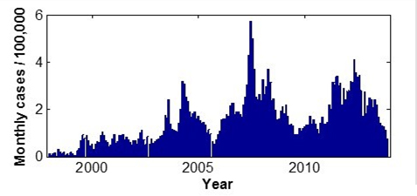
Alarming Trend in Cases
Notes:
This is how pertussis looks like in the last 15 years
אחת מעשר המחלות הקטלניות בעולם
Deaths:
1990 – 138K
2013 – 61K
Pertussis is the only vaccine-preventable disease that is associated with increasing deaths in the U.S

Slide 3
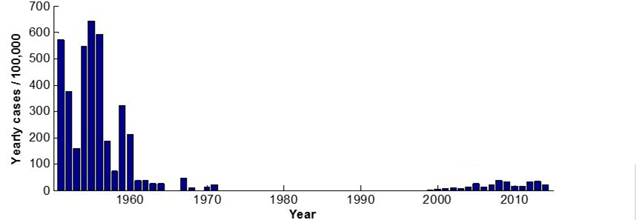
Alarming Reemerging Trend in Cases
Introduction of whole cell vaccine
Switch to acellular vaccine
Notes:
But apparently it’s a trend from previous years
1957 – Start of vaccine
2002, 2006 – important milestones
Reemergence raised as questions

Slide 4
Rise of Pertussis in Israel
Is there a real of pertussis in Israel?
Notes:
Explain what is pertussis: Contagious disease, affects children, could be lethal.

Slide 5

The Epidemiological daTA
16 years of daily records of pertussis incidence
For each patient, detailed information about
Age
Place of residence
Country of birth
Ethnicity
Laboratory confirmed cases
Hospitalizations
Vaccination status

Slide 6
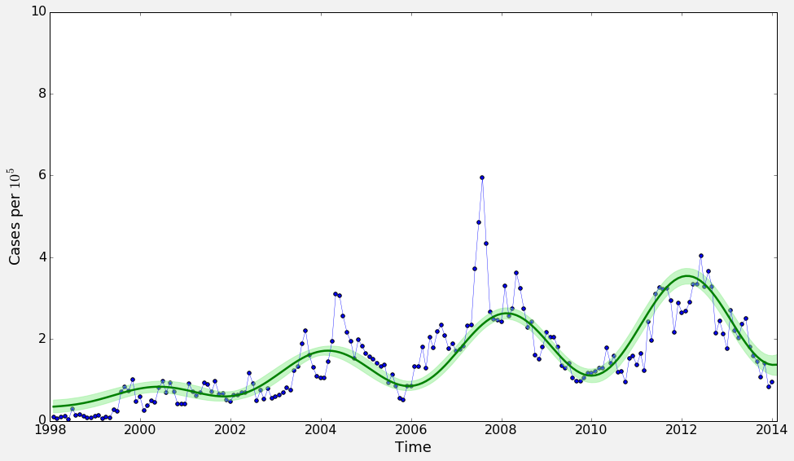
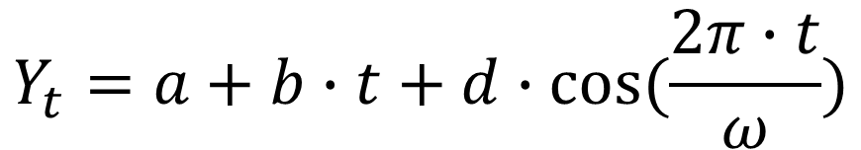
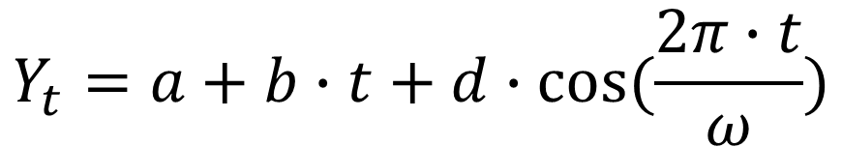
Fit a Model
$$Y_{t}=a+b∙t+d∙cos⁡(\frac{2π∙t}{ω})$$
An obvious trend upwards
4-year periodicity

Slide 7
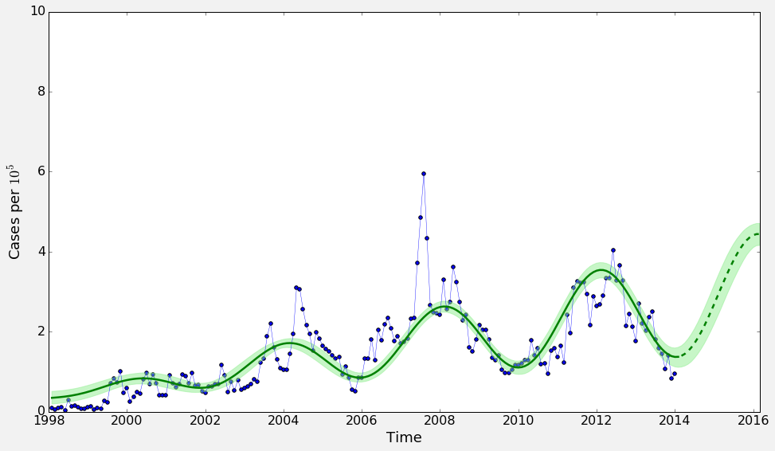
Fit a Model
An obvious trend upwards
4-year periodicity
Rise predicted to start 2014 with a peak predicted for early 2016

Slide 8
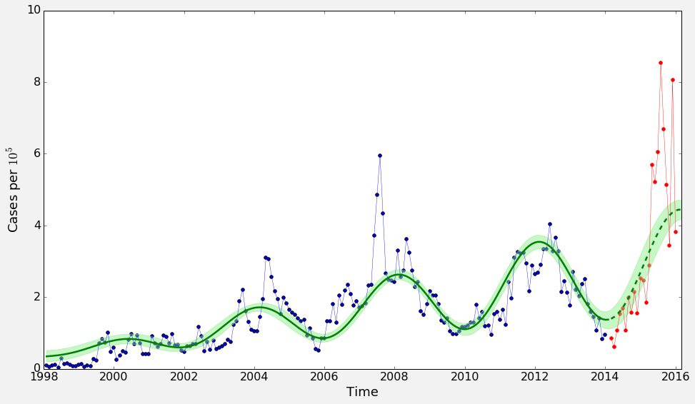
Fit a Model
An obvious trend upwards
4-year periodicity
Rise predicted to start 2015 with a peak predicted for early 2016
Compared against new data

Slide 9
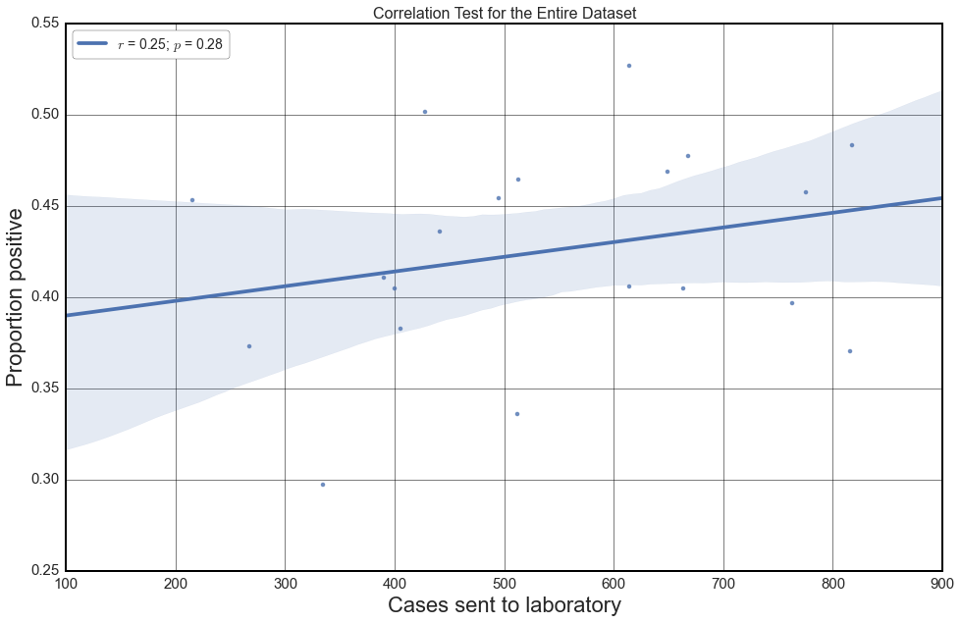
Overall Trends
There is no correlation between the number of tests and proportion of positive cases

Slide 10
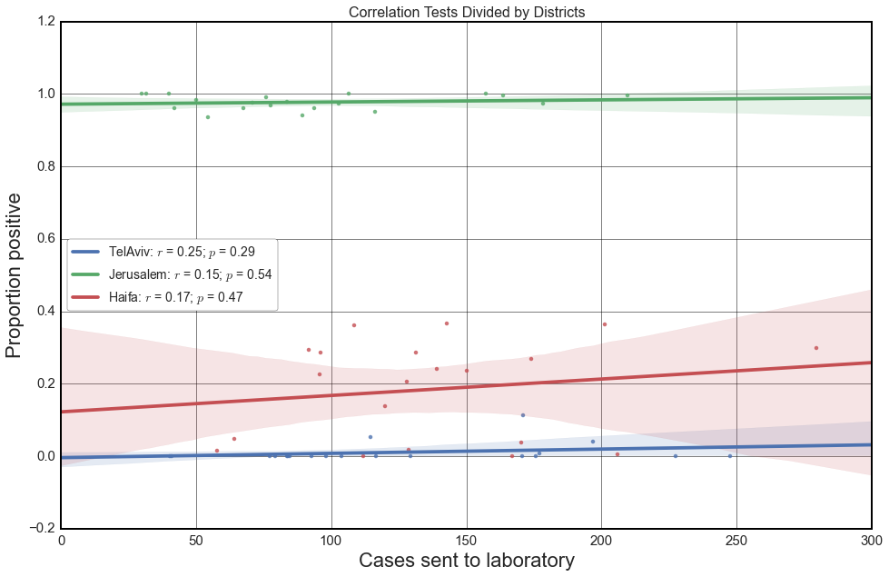
Overall Trends
There is no correlation between the number of tests and proportion of positive cases
Even when stratifying by
Districts

Slide 11
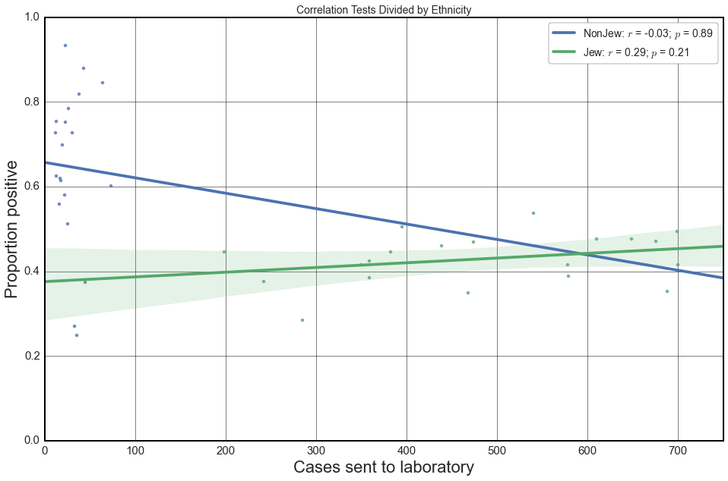
Overall Trends
There is no correlation between the number of tests and proportion of positive cases
Even when stratifying by
Districts
Ethnicity

Slide 12
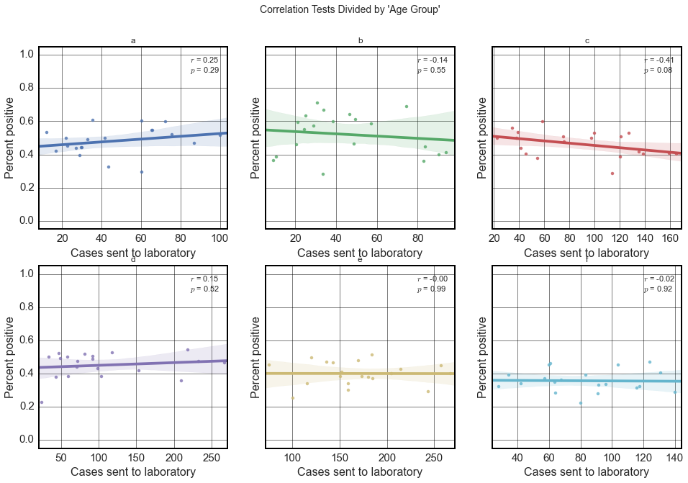
Overall Trends
There is no correlation between the number of tests and proportion of positive cases
Even when stratifying by
Districts
Ethnicity
Age

Slide 13
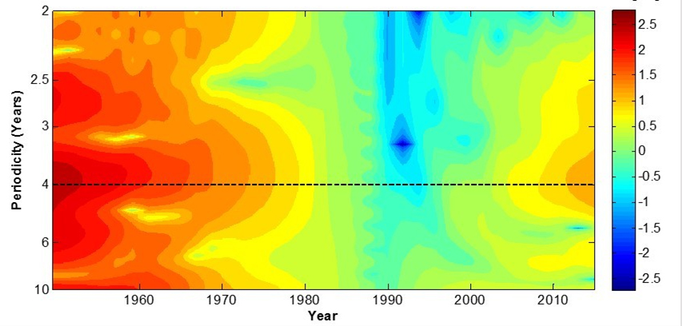
Short-Time Fourier-Transform
Notes:
STFT Brings it home for periodicity

Slide 14
Optimizing Vaccination Policy

Slide 15
Epidemiology 101

Slide 16
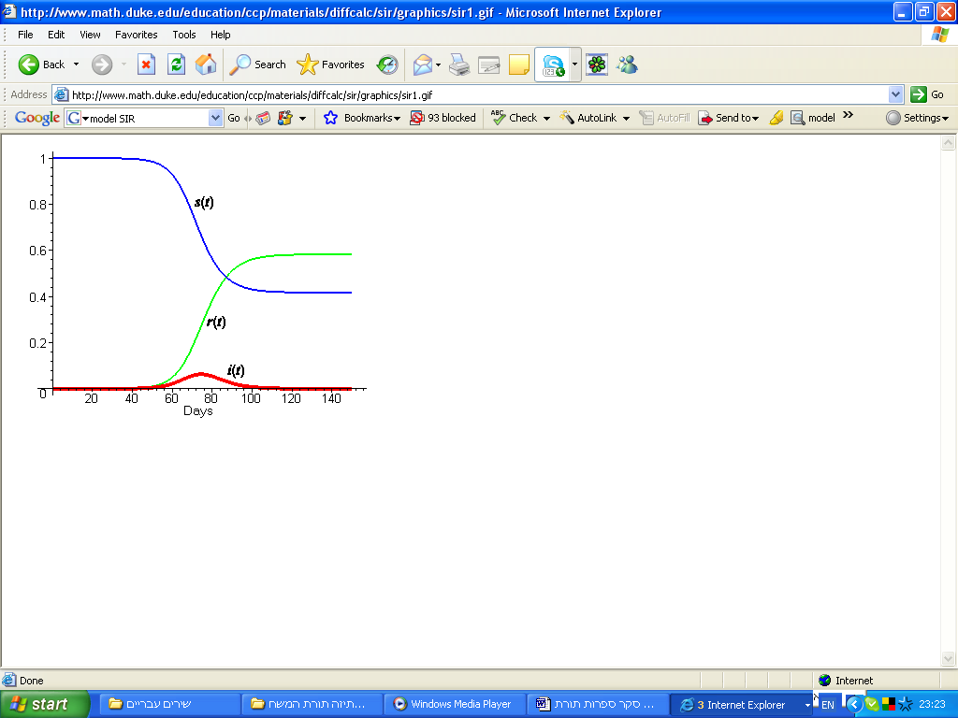
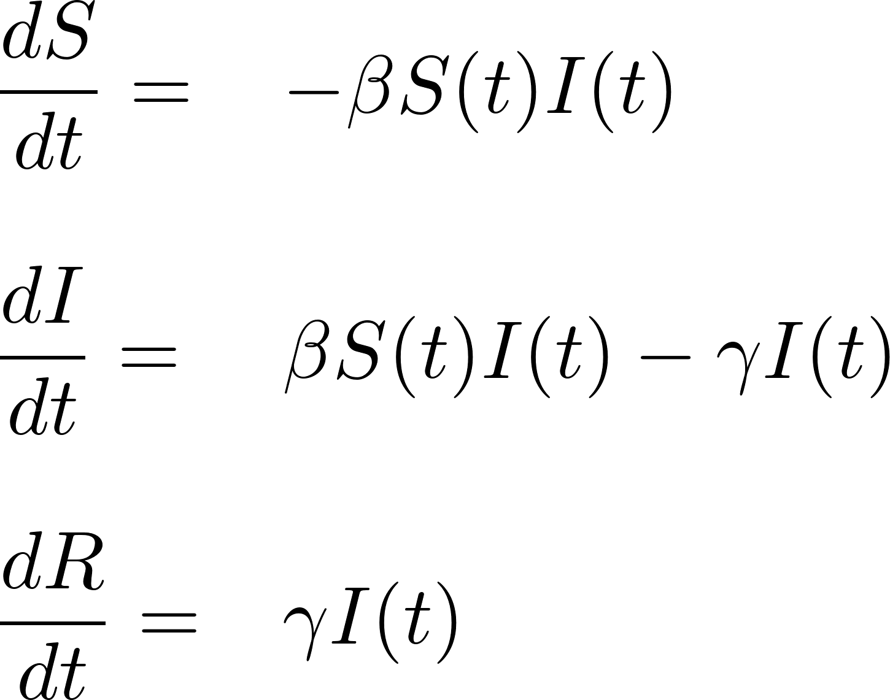

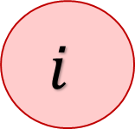
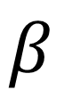
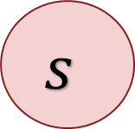
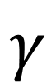

S-I-R Model
$$β$$
$$γ$$
Compartments:
$s – Susceptible$
$i – Infectious$
$r – Recovered$
Parameters:
β – Force of infection
γ – Rate of recovery
$$s$$
$$i$$
$$r$$
proportion
Days

Slide 17
Population Model

Slide 18
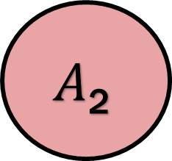
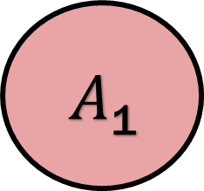
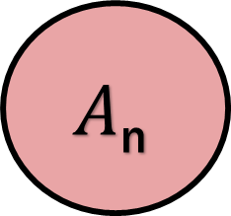
Population Model
Birth
$A$₁
$$A\text{2}$$
$$A\text{n}$$
Death
Aliyah/ Yerida
Aliyah/ Yerida

Slide 19

The CBS Data
Yearly age distribution clustered into age groups of five year intervals for Israeli Arabs and Jews
Yearly death rates in Israeli Arabs and Jews
Door to door social studies about sub divisions of the Jewish populations
Specifications of fertility rate by age group of ultra orthodox Jewish women

Slide 20
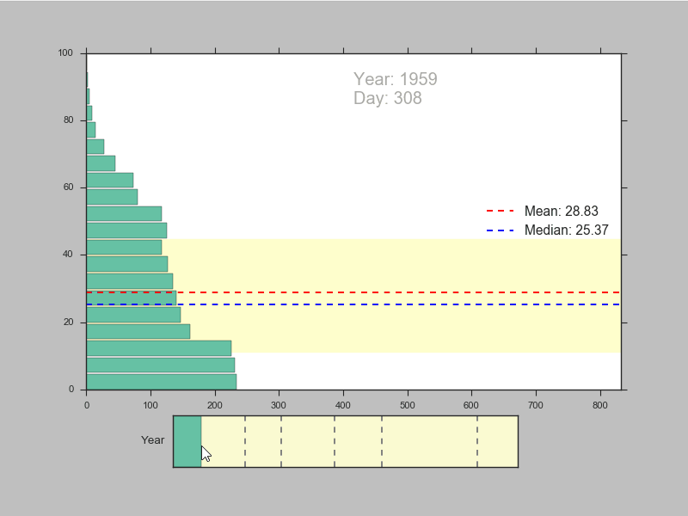
All
Interactive Module to explore population distribution
Israel as a whole looks like a fairly regular OECD country

Slide 21
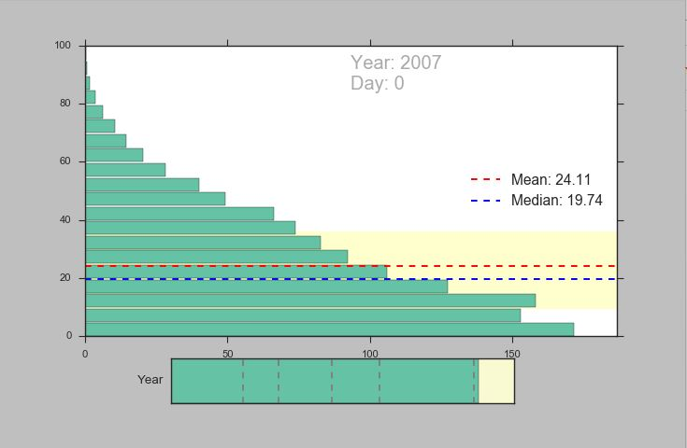
Arabs
Arab population starts like a developing country
Becomes fairly modern near the end of the centrury

Slide 22
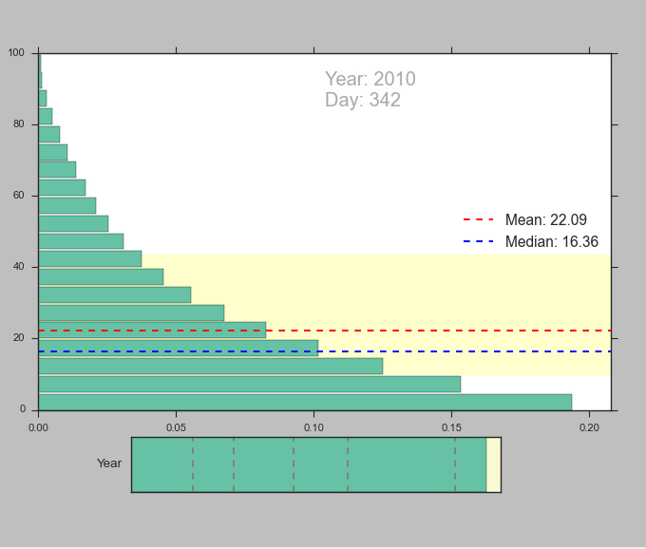
Orthodox Jews
¼ of the population under 10

Slide 23
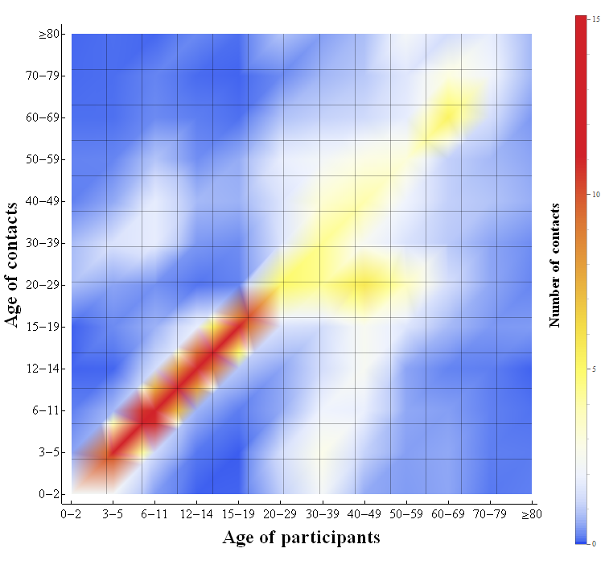
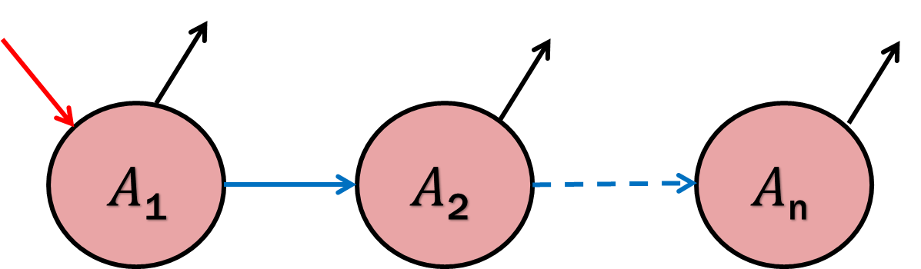
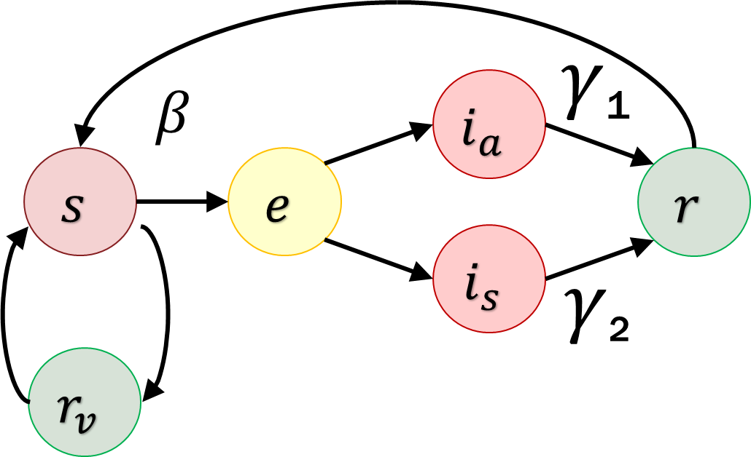

Full Transmission Model
Parameters:
$β$ → $βjCij$

Slide 24
Mixing Patterns

Slide 25

The GPS Data
2 Months of cellular activity from one of Israel’s leading telecom companies
2 TB of data
35 Billion records
1.6 Million Users
Many features, including:
Calls
SMS
Location

Slide 26
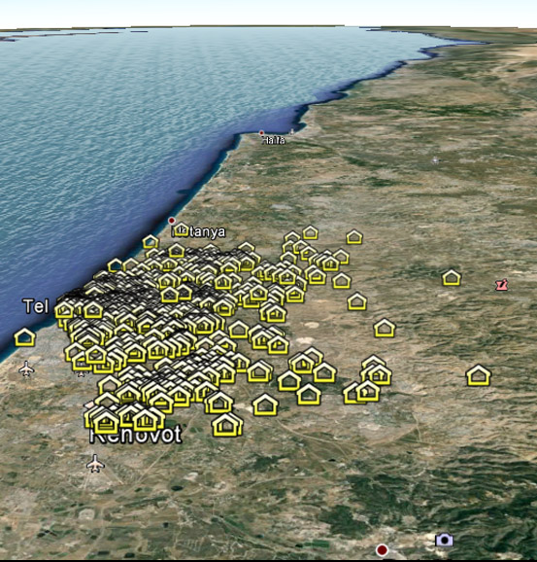
Generation of contact mixing patterns between the sub-populations
1. Finding place of residence for each user

Slide 27
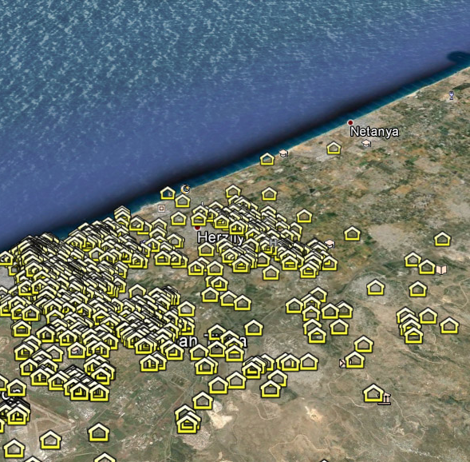
Generation of contact mixing patterns between the sub-populations
1. Finding place of residence for each user

Slide 28
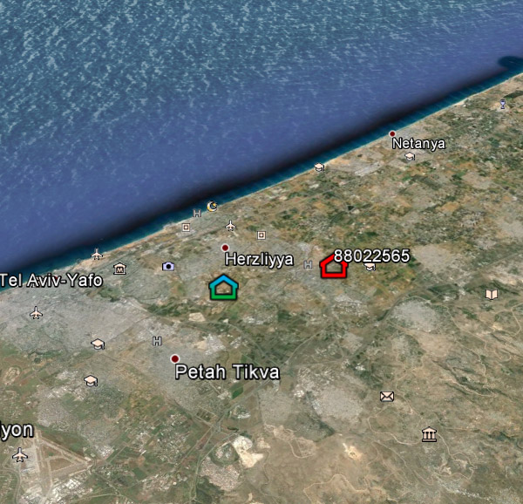
Generation of contact mixing patterns between the sub-populations
2. Assigning sub- population based on the place of residence

Slide 29
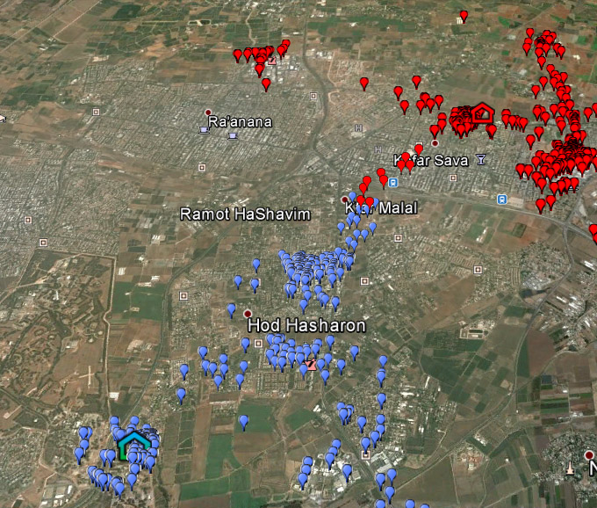
Generation of contact mixing patterns between the sub-populations
3. Tracing trails

Slide 30
Generation of contact mixing patterns between the sub-populations
4. Defining a contact based on time interval and space

Slide 31
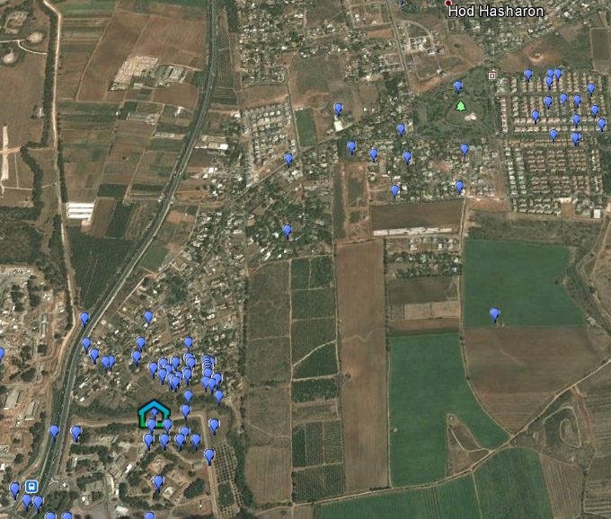
Generation of contact mixing patterns between the sub-populations
Evaluating in a given space and time the probability to encounter an individual from each sub-population
Defining contacts for each individual based on tracers along the locations

Slide 32
Cost Effectiveness Analysis
Population Dynamics
Transmission Model
Contact Mixing Patterns
Cost Effectiveness Analysis
Pluggable apps approach
Run simulations on fitted data
Design different scenarios
Optimize allocation

Slide 33
Summary
Evidence for reemergence of pertussis
Build transmission model
Conduct simulation studies to optimize vaccination allocation
Recommend a new vaccination policy

Slide 34
?
Questions

Slide 35

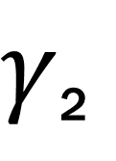

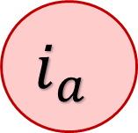
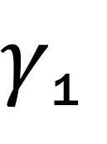
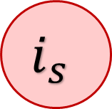

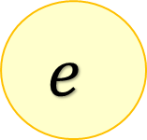
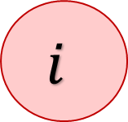

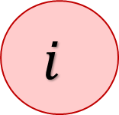
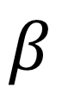
S-E-I-R Model
Compartments:
$s – Susceptible$
$e – Exposed$
$i_{a} – Infectious$
$asymptomatic$
$i_{s} – Infectious$
$symptomatic$
$r – Recovered$
$r_{v}$ - Vaccinated
$γ$₁
$$β$$
$$i_{a}$$
$$s$$
$$e$$
$$i$$
$$i$$
$$r$$
$$i_{s}$$
$γ$₂
$$r_{v}$$

